Slide 1
High Accuracy Cancer Prediction Using Machine Learning Inspired Mass Spectrum Analysis
Peter Liu
2018.6

Slide 2
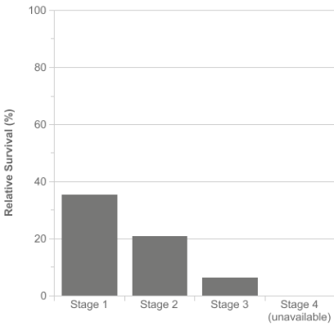
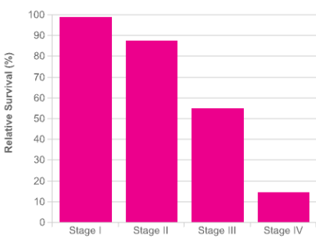
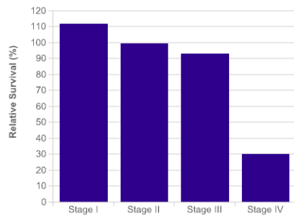
Top 3 Cancers in United States
Five Years’ Survival Rates at Different Stages
Breast Cancer Lung Cancer Prostate Cancer
Survival rate decreased exponentially when cancer is diagnosed at later stage
Early Detection is Important to increase SURVIVAL RATE!
Cancer Statistic Source from: http://www.cancerresearchuk.org

Slide 3
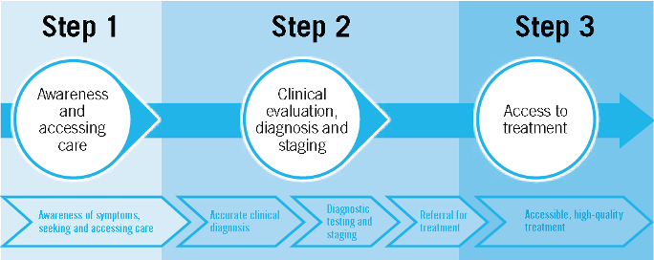
Cancer Diagnosis
Problems:
Some cancer does not have symptoms
Not noticeable until late stage
Routine check up specifically for cancer is not affordable

Slide 4
Early detection of cancer
Goal
SHOTGUN METHODS
Analyze routine check up samples, e.g. blood samples, and collect as much information as possible for cancer detection
‘RED FLAG’ SUSPECTS
Identify samples that have high probability of cancer and recommend for further testing

Slide 5
Who cares?
Survival Rate
Insurance
Companies
Patients
Medical Cost
Doctors
Life Quality
Pharmaceutical
Companies
Drug Development for Early Cancer

Slide 6
SHOTGUN METHOD
Mass Spectroscopy
- Collect mass information of all chemicals
Low Sample Loading
Milligram (1/1000 grams) samples
High Sensitivity
- Detect trace amount of chemicals at part per billion(ppb) level
High Throughput Screening
- Easily coupled with robotic sample preparation process and results obtained within minutes

Slide 7
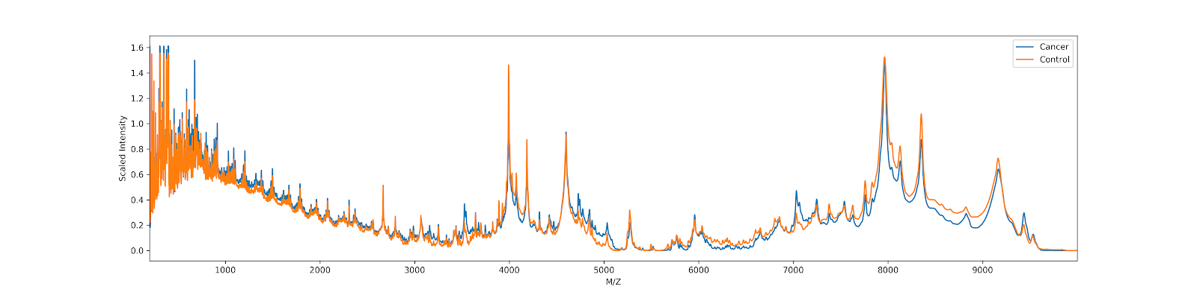
Problems with Shotgun Method
Difficult to compare unless you already know which peak is the determinant
Too much information!

Slide 8
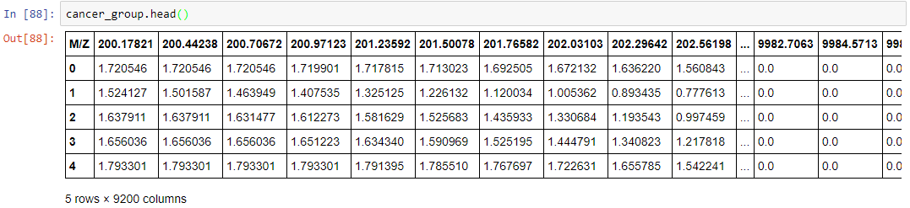
Real-world Problem to ML Problem
Real-world Problem
Machine Learning Problem
Select Determinant Masses
Predict Cancer
Feature Engineering
Classification
Determinant Masses Selection vs. Important Features Selection
Cancer/No Cancer
vs.
1/-1

Slide 9
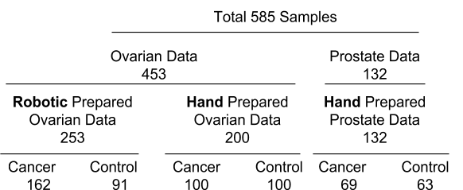
Data Source
Sample mass spectra collected from National Cancer Institute (NCI)
Two cancers
Three groups
Six subgroups

Slide 10
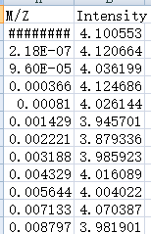
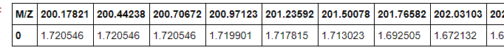
Data Wrangling
‘Long’ single MS data
Mass cutoff
Scaling
Transpose
‘Wide’ single MS data
Mass values
Concatenation by Row
Mass Spectra Data Matrix
Mass values
Samples

Slide 11


Exploratory Data Analysis
Heatmap is more preferable than plot view
Plot view of data
1D Heatmap

Slide 12
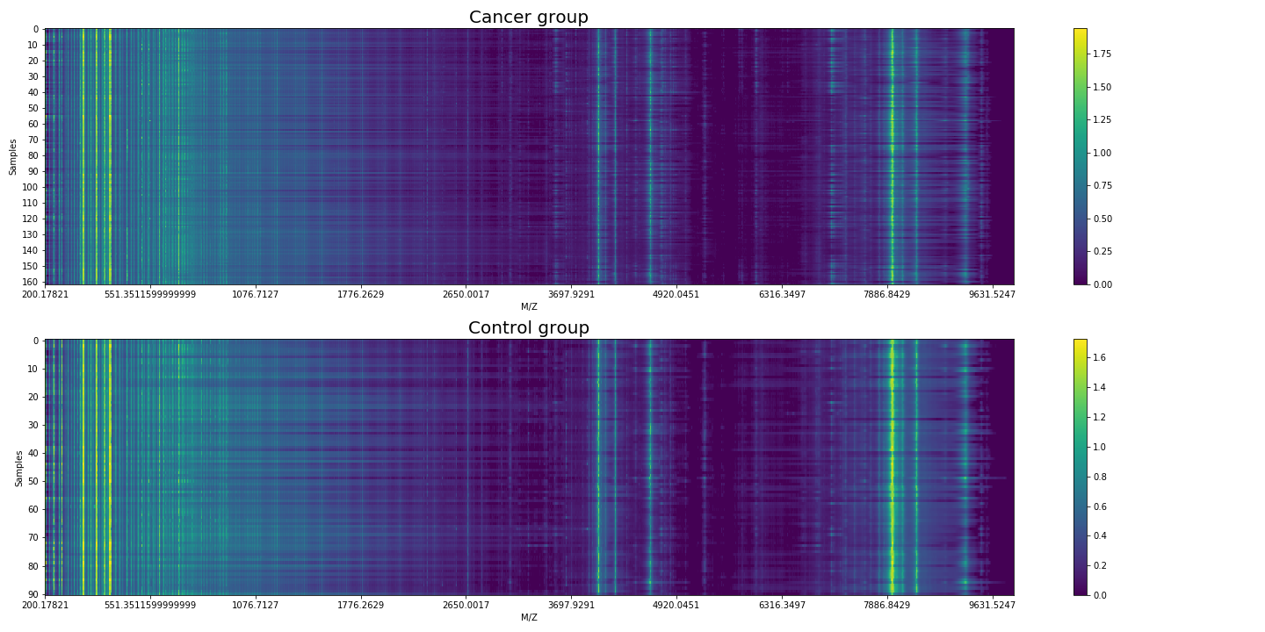
Exploratory Data Analysis
Heatmap of robotic prepared ovarian datasets
Difficult to tell the difference between cancer and control group

Slide 13
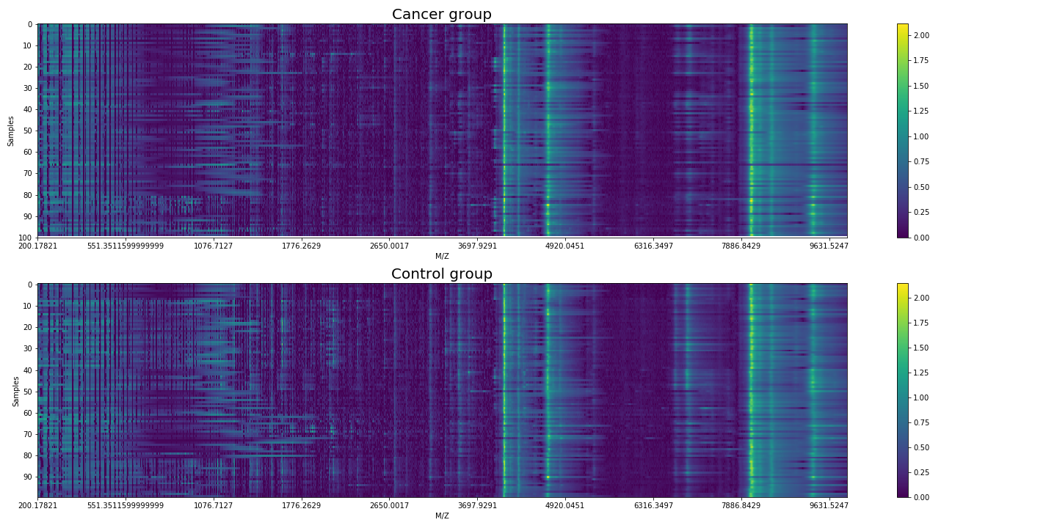
Exploratory Data Analysis
Heatmap of hand prepared ovarian datasets
Difficult to tell the difference between cancer and control group

Slide 14
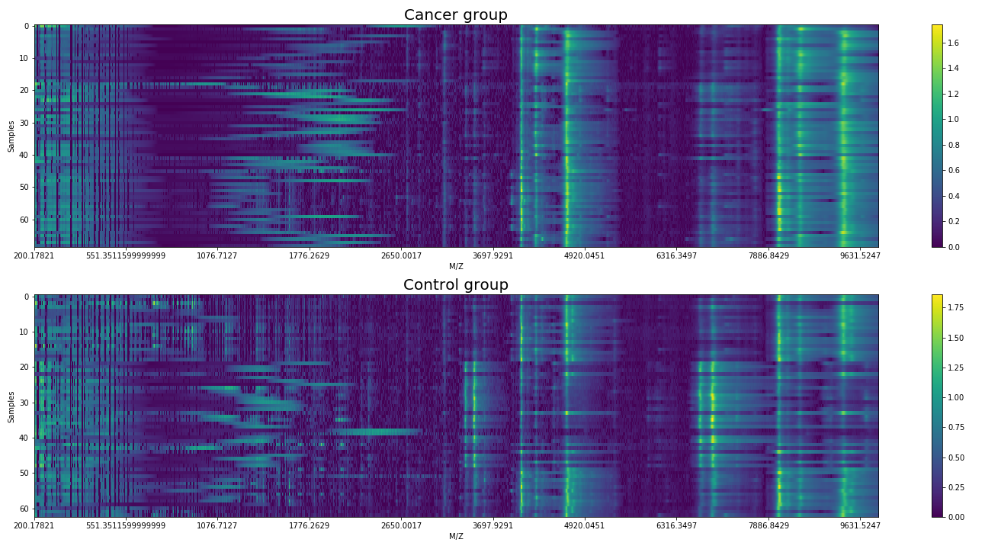
Exploratory Data Analysis
Heatmap of hand prepared prostate samples
Difficult to tell the difference between cancer and control group

Slide 15
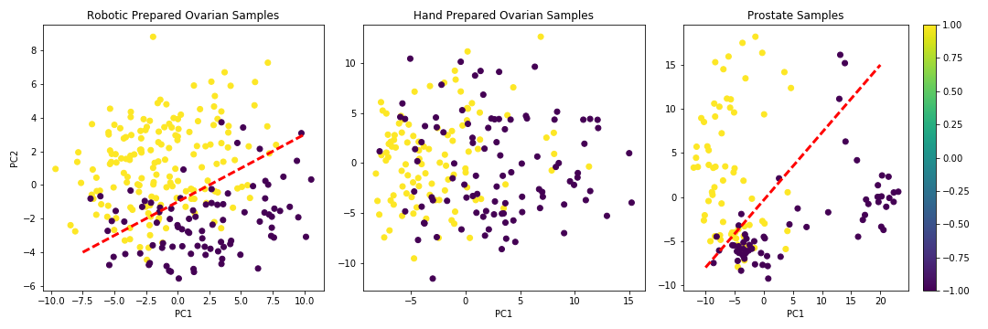
Data Visualization in 2D
Figure. Comparison of cancer and non-cancer group in three datasets. Purple plots represent non-cancer group, while yellow plots represent cancer group. From left to right: robotic prepared ovarian samples, hand prepared ovarian samples, and prostate sample

Slide 16
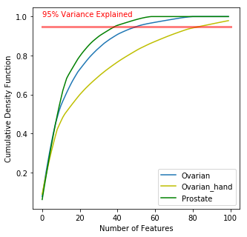
Feature Selection
Important Features == Fingerprint Mass
Figure. Explained Variance vs. Number of Features rendered by Random Forest. Decision Tree is a natural way of feature selection.

Slide 17
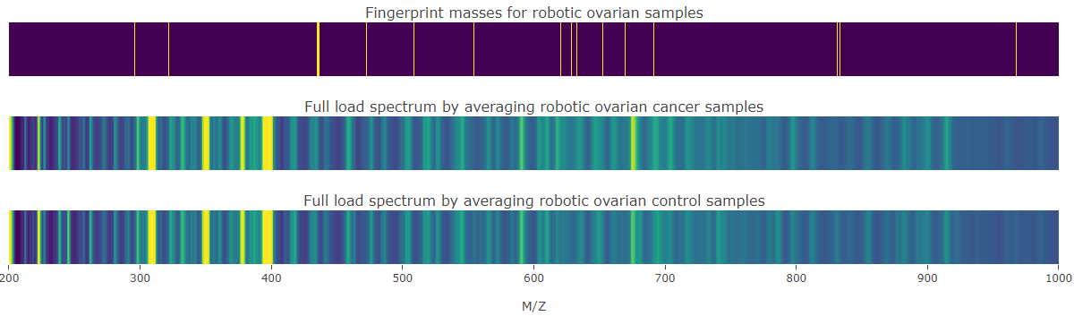
Feature Selection
Fingerprint masses for robotic prepared ovarian samples
The number of fingerprint masses between 200 and 1000 are 25
One key molecule (molecular weight 472) to determine ovarian cancer is in our important mass list for ovarian prediction
Figure. Selected fingerprint masses for robotic prepared ovarian samples

Slide 18
Models for Cancer Prediction
Table 1. Comparison of different models on cancer prediction
Datasets | Measure | Models after tuning parameters
 |  | KNN | Random Forest | SVM | Ensemble by Voting
Ovarian Robotic | Accuracy | 0.99 | 1.00 | 1.00 | 0.99
 | AUC | 0.99 | 1.00 | 1.00 | 0.99
 | F1-Score | 0.99 | 1.00 | 1.00 | 0.99
Ovarian Hand | Accuracy | 0.93 | 0.92 | 0.95 | 0.95
 | AUC | 0.93 | 0.91 | 0.94 | 0.96
 | F1-Score | 0.94 | 0.93 | 0.96 | 0.96
Prostate | Accuracy | 0.95 | 0.98 | 0.98 | 0.98
 | AUC | 0.95 | 0.97 | 0.97 | 0.98
 | F1-Score | 0.96 | 0.98 | 0.98 | 0.98

Slide 19
FP and FN
Which model is better in early determination of cancer?
We want lower rate of false negative (FN/fail to detect cancer)
Predicted Actual | -1 (No Cancer) | 1 (Cancer) | Total
-1 (No Cancer) | 23 | 3 (FP) | 26
1 (Cancer) | 0 (FN) | 34 | 34
Total | 23 | 37 | 60
Model 1
Predicted Actual | -1 (No Cancer) | 1 (Cancer) | Total
-1 (No Cancer) | 23 | 0 (FP) | 26
1 (Cancer) | 3 (FN) | 34 | 34
Total | 23 | 37 | 60
Model 2

Slide 20
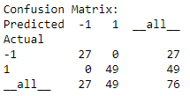
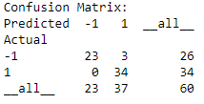
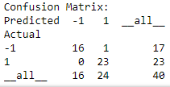



SVM vs. Ensemble
SVM
Prostate Samples
Robotic prepared Ovarian Samples
Hand prepared Ovarian Samples
Ensemble
SVM is our best model
0% of FN rate (fail to detect cancer) by SVM

Slide 21
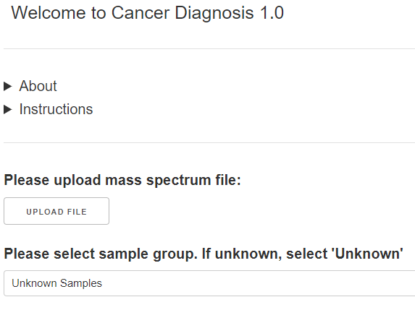
Cancer Diagnosis 1.0
Web App developed based on Dash
Simply upload spectrum file and cancer diagnosis results will be shown
Upload file
Upload mass spectrum csv/excel from your own computer

Slide 22
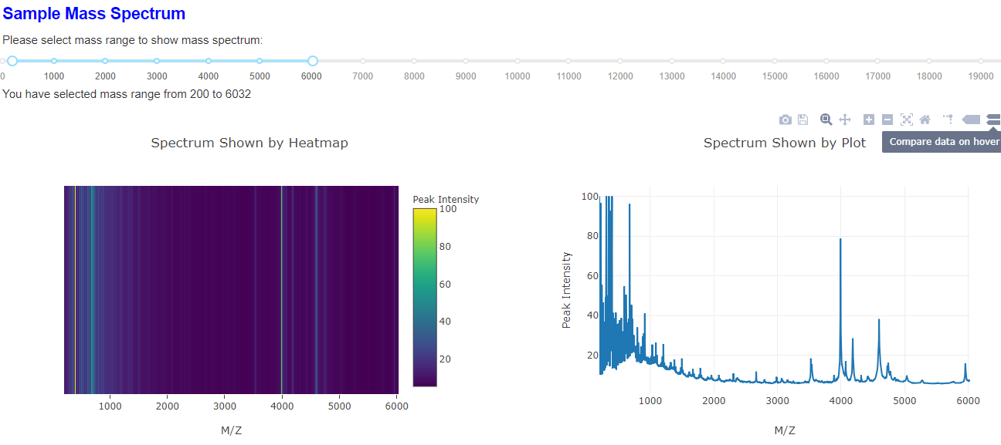
Mass Spectrum Preview
Mass spectrum will be shown using heatmap and plot, and you can choose the mass range

Slide 23
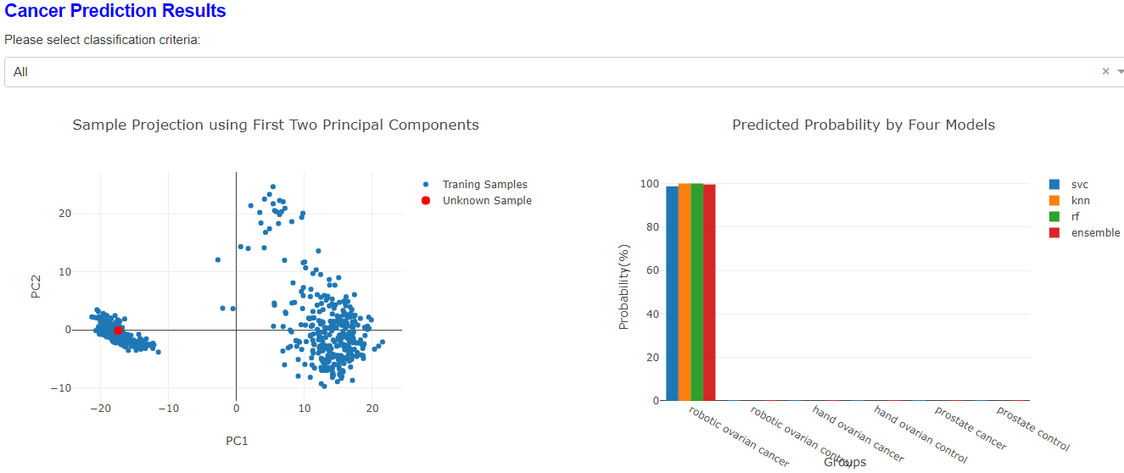
Classification of Unknown Sample
It shows the visualization of new sample within training samples and predict the probability by four models. You can choose different classification criteria: all, sex or preparation

Slide 24
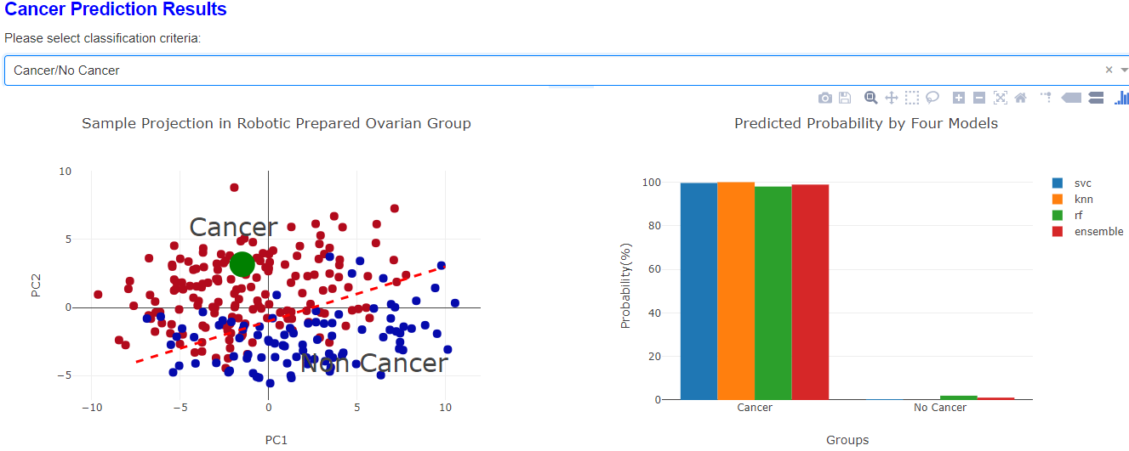
Prediction of Cancer/No Cancer in Specific Group
If you choose specific group (Robotic prepared ovarian group herein), it shows the visualization of new sample within training samples in this group, and predict the probability of cancer/no cancer by four models

Slide 25
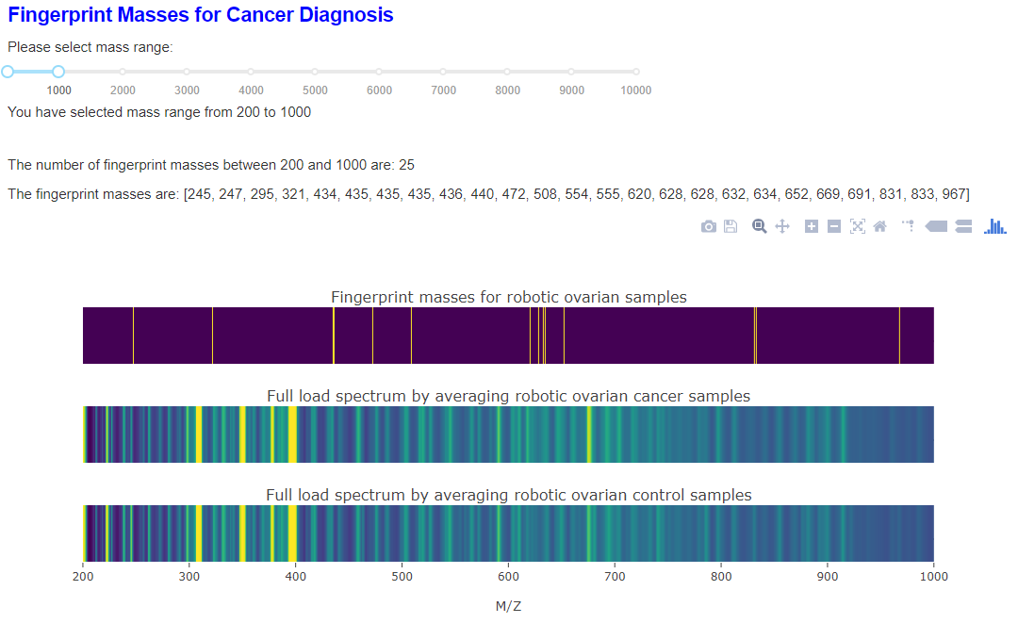
Fingerprint Masses in Specific Group
It will also show the fingerprint masses within specific group (robotic prepared ovarian group herein), you can select the mass range to show interested fingerprint masses

Slide 26
Conclusion
SVM were selected as the best model to predict ovarian and prostate cancers with high accuracy (95-100%), and 0% false negative rate, making it ideal to ‘red flag’ the suspected cancer samples
One of the fingerprint molecules determining ovarian cancer was identified, which is confirmed by literature report
A cancer diagnosis app was developed to offer quick cancer prediction results as well as lists of fingerprint molecules for cancer diagnosis

Slide 27
Recommendations
Patients should ask for mass spectrum test during routine check up for cancer screening
Doctors should recommend patients to do mass spectrum test during routine check up
Insurance company should cover the mass spectrum test fee as preventative test to encourage people do routine cancer screening

Slide 28
Goal of Early Cancer Detection
√ SHOTGUN METHODS
Analyze routine check up samples, e.g. blood samples, and collect as much information as possible for cancer detection
√ ‘RED FLAG’ SUSPECTS
SVM were selected as the best model to predict ovarian and prostate cancers with high accuracy (95-100%), and 0% false negative rate
? Increase the number of training/testing samples
? Add more cancers
? To be added…

